Slide 1
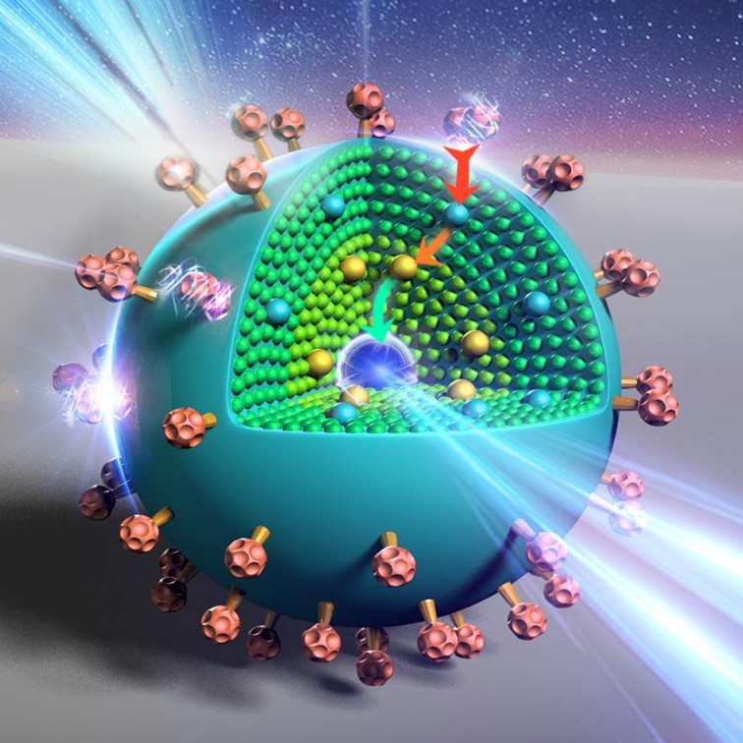
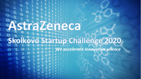
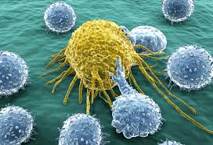
NANODOC – a new multifunctional nanoparticle platform for cancer treatment
CA Nanotherapeutics
Safer treatments for cancer patients.
Prof Dmitry Pshezhetskiy, MBBS, BSc, MSc, PhD, FHEA
CSO CA Nanotherapeutics

Slide 2
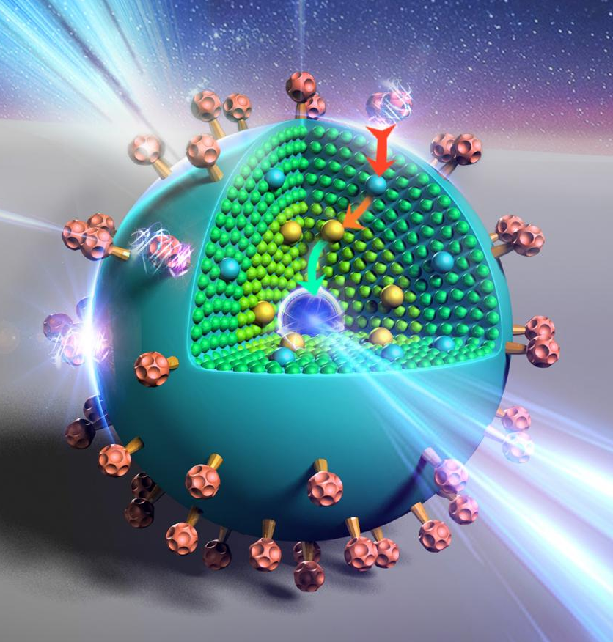
Introduction
NANODOC provides:
targeted drug delivery to tumours
increased efficacy
low toxicity
imaging capability
Future potential:
platform technology
additional novel combinations
multiple solid tumour targets
Winner
Our ask: 2M USD for preclinical development to start Phase I
Two work programmes 800k and 1.2M respectively

Slide 3
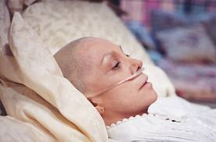
Need/Market
Jane has advanced breast cancer
Current gold-standard chemotherapy is however not curative due to chemoresistance.
There are currently 4.6 million patients with breast and prostate cancers in the US and UK alone.
Nanoformulations can deliver drugs to tumours and provide better efficacy and toxicity
Cancer therapeutics market: $220b estimated in 2024 ($50b prostate and breast cancers).

Slide 4
Competition
Currently 7 nanoformulations on the market: 2 in the EU, 5 in the US – all single therapy formulations.
Example:
Abraxane (albumin-bound paclitaxel) - Celgene
Doxil (doxorubicin liposome) - Janssen
DaunoXome (liposomal daunorubicin) - Galen
Marqibo (liposomal vincristine) - Spectrum
Onivyde (liposomal irinotecan) - Ipsen
Myocet (non-PEGylated liposomal doxorubicin) - Teva
Mepact (liposomal mifamurtide) - Takeda
Only slight increase in efficacy compared to free drug.
Cancer cells eventually develop resistance through activation of alternative pathways

Slide 5
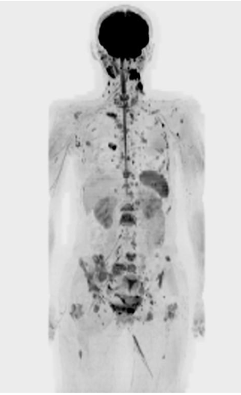
Approach
NANODOC - biodegradable polymer nanoparticle containing a combination of molecular targeted therapy and chemotherapy.
100 nm
Targeted to tumour by:
Permeability/retention
Hyper-glucose metabolism
Applies to MOST solid tumours
NP
Can carry several therapeutic molecules eg. Docetaxel + Fingolimod
Patent: WO/2018/115835
Anticancer agents

Slide 6
Benefit: NANODOC outperforms abraxane (new nanoparticle for breast cancer) and anti-PD1 immunotherapy and shows no toxicity
(docetaxel + fingolimod) - NANODOC
NANODOC showed no weight loss, no liver/kidney/blood toxicity
Highly aggressive 4T1 mouse mammary tumours in immunocompetent Balbc mice

Slide 7
Benefit
The advantages of NANODOC vs current gold-standard or newly developed nanoparticle solutions for breast cancer
 | Conventional Chemotherapy | Abraxane (new paclitaxel nanoparticle) | Immune therapy | NANODOC
Targeting (specificity) | Low | Medium | None | High
Efficacy (chemosensitization) | Low | Low/Medium | Variable/medium | High/Medium
Toxicity (no side effects) | High | Medium | Variable/high | Low
Imaging capability | None | None | None | MRI
Stability | Low | Medium | n/a | High
Versatility | None | None | None | Possible
Cost | Low (7k/patient) | Medium (14k/patient) | Very high (100+k/patient) | Medium (14k/patient)

Slide 8
Business strategy
Phase I study (King’s College)
1. Preclinical development of NANODOC
Exit: licensing or sale
2. Developing a drug pipeline using nanoparticle platform
Two more patents in submission
3. Partnering with pharma companies – testing their therapies in our system
Our ambition to become a leader in multitherapy nanoparticle drug development

Slide 9
Financial Forecast
Forecast element (GBP ‘000’s) | Period
 | Current project Months 1-18 | Months 19-36 | + 3 year | +4 year
Investment | 2,000 | +4,000 | +10,000 | +25,000
Revenues (platform) | 0 | 1,000 | 5,000 | 10,000
Valuation | 6,500 | 12,000 | 50,000 | 85,000
R&D spend (cumulative) | 2,000 | 5,500 | 15,500 | 40,000
FTEs | 4 | 6 | 10 | 16
Milestones | Authorisation for phase I | Complete phase I NANODOC | Stable revenues from platform service and pipeline therapies sales/licensing
Sale or licensing of NANODOC, USD 100m+

Slide 10
ASK: Product development – NANODOC
Preparing to phase I. Months 1-18, Total costs: USD2M
Two work packages
WP1 (months 1-12). MTD, pharmacokinetics, pharmacodynamics, comparative efficacy
WP1:
800k
WP2 (months 6-18). Defining a robust manufacturing process for GLP industrial nanoparticle synthesis and establishing critical quality attributes (CQAs) and associated process control strategy.
WP2:
1.2m

Slide 11
De-risking steps
1. All individual ingredients are already used in human patients – known doses and side effects. Discussed with MHRA – facilitated route to clinic (waived GLP toxicology as we use human-equivalent doses )
2. Already obtained agreement for Phase I trial at Kings College London, clinical oncologists very interested.
3. Upscale synthesis successfully performed by Precision nano.
Chances of preclinical and phase I success > 80%

Slide 12
Team and partners
CA Nanotherapeutics
CEO - Tim Mustill
CSO - Prof Pshezhetskiy
Chemist - Dr Wang
Pharmacist - Dr Alshaker
CPI -drug development
MDC Catapult - preclinical validation
Kings College
Prof James Spicer, Consultant Clinical Oncologist and Head of Phase I Trials Unit
Precision Nanosystems -
preclinical development
Covance - PK/PD and toxicology

Slide 13
Conclusion
NANODOC provides:
targeted drug delivery to tumours
increased efficacy/low toxicity
imaging capability
Future potential:
platform technology
additional novel combinations
multiple solid tumour targets
Combined cancer therapy with targeted delivery will be tomorrow’s gold-standard
Looking for investors
d.pshezhetskiy@uea.ac.uk
https://youtu.be/Y535aco3A1s

Slide 14
Appendix follows

Slide 15
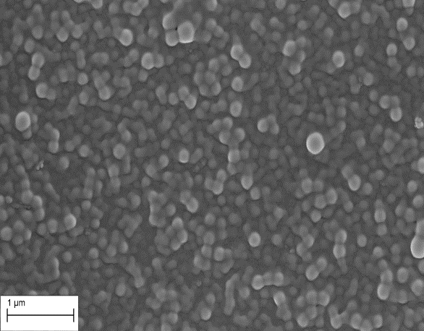
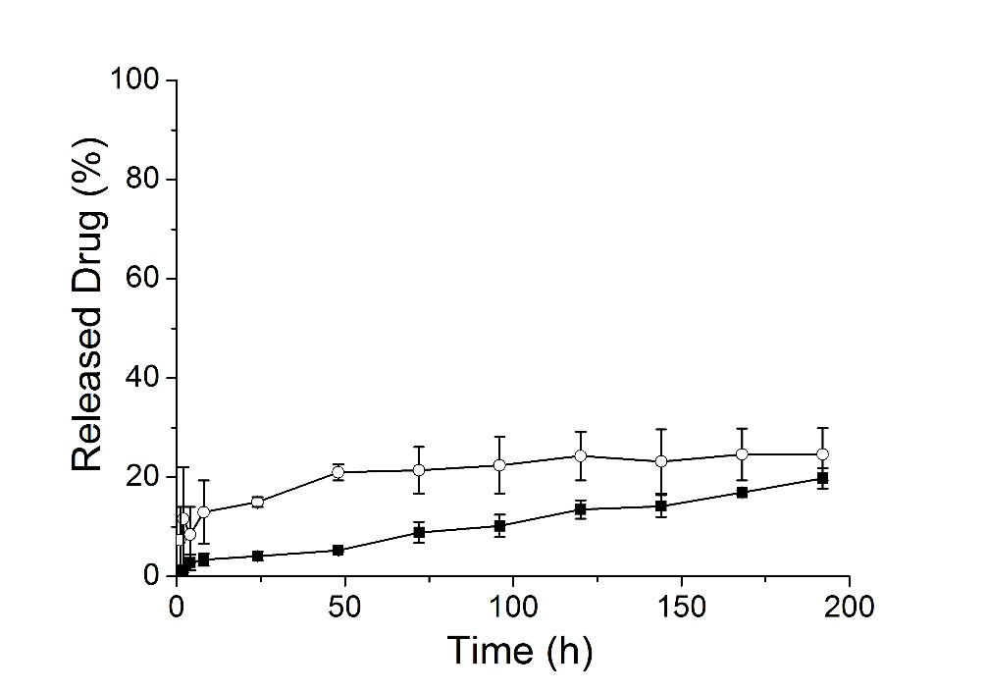
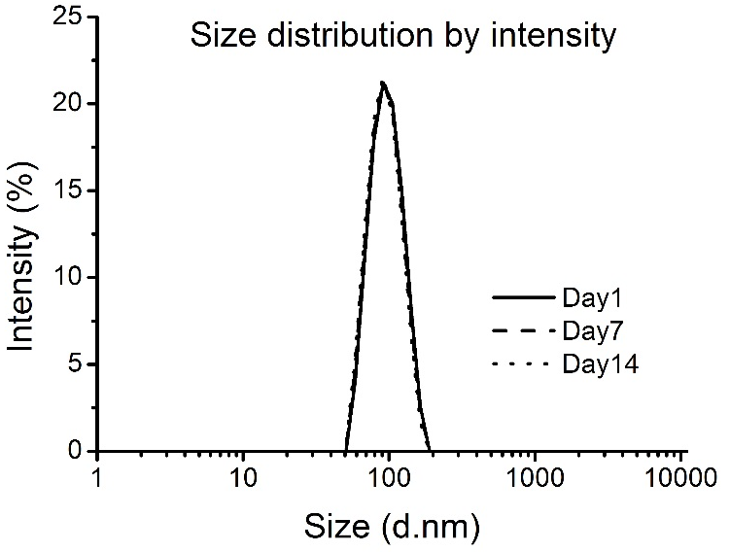
Characterisation
Nanoparticles show narrow size distribution and sequential drug release at lysosomal pH 5.5.
*
*
*
*
**
1 µm
<20% drug release at pH 7.4 or in serum
Alshaker et al, Breast Cancer Res Treat 2017 Oct;165(3):531-543

Slide 16
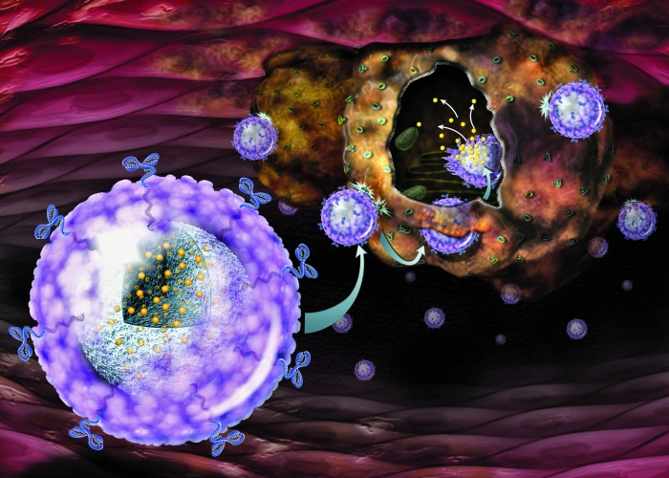
Nanoparticles for drug delivery
Solution for overcoming chemoresistance
Encapsulation of drugs in nanocarriers.
Tumour targeting
(Size, nanoparticle labelling)
Toxicity reduction
(drugs linked to polymer and inactive)
Co-delivery of novel combinations

Slide 17
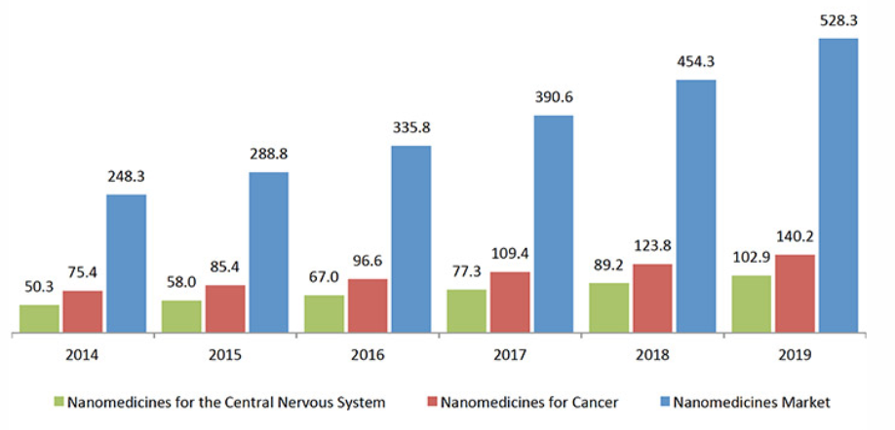
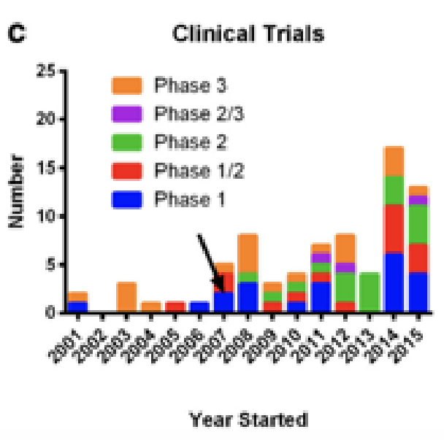
Nanomedicine – a growing market
o Global nanomedicine market is expected to witness high growth in the next years
o Rise in players: Merck, Teva, Pfizer, Johnson & Johnson, Abbot, GE Healthcare, etc.
o More than 50 nanopharmaceuticals FDA approved
2019 – 386 total nanoparticle trials on trials.gov
Nanoparticle/Cancer/Phase 3 – only 15
Drug combination – 6, in one nanoparticle - 0

Slide 18
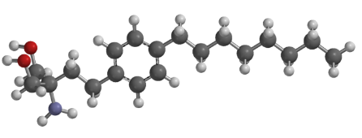
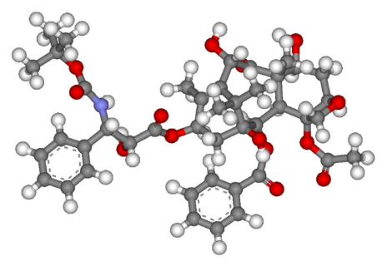
Chemosensitisation
Our approach to resistance is chemosensitisation using molecular targeted therapy. We identified proto-oncogene SK1 as a target.
SK1 inhibitor fingolimod (MS therapy Gilenya) can sensitise cancer cells to docetaxel chemotherapy
Fingolimod allows 4-fold reduction in effective docetaxel dose
fingolimod
Docetaxel
chemotherapy
Inhibits proto-oncogenic enzyme SK1
Blocks mitosis
However, fingolimod cannot be given to cancer patients in free form due to reducing white cell counts
Cancer cell
Cuts-off survival, growth and resistance signals

Slide 19
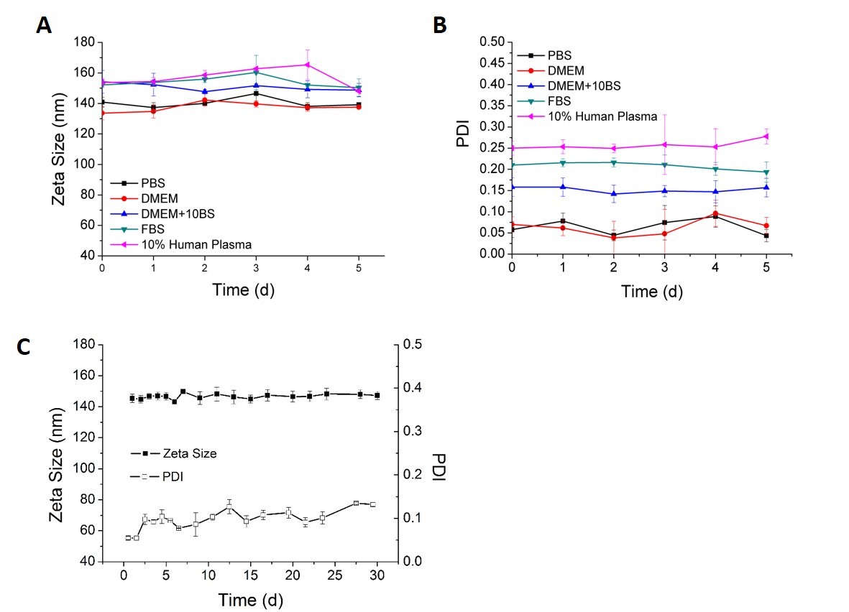
Characterisation
Nanoparticles are stable in saline and plasma
A) Size and B) polydispersity index (DLS). C) Size and PDI measurements of CSLPHNPs suspended in PBS and stored at 4C for 30 days.
Wang et al, Scientific Reports 2017, 7: 5901
Alshaker et al, Breast Cancer Res Treat 2017 Oct;165(3):531-543

Slide 20
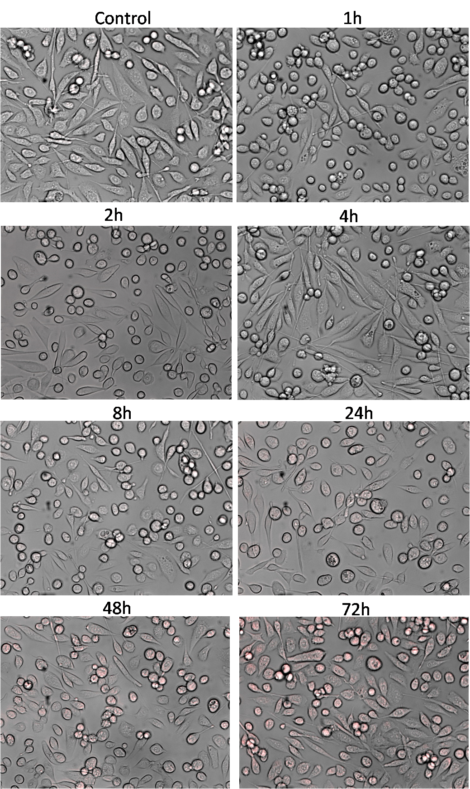
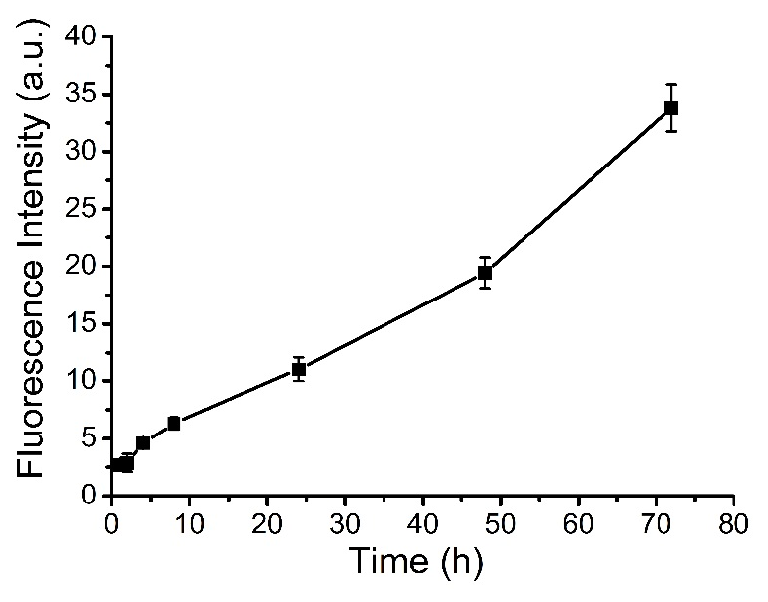
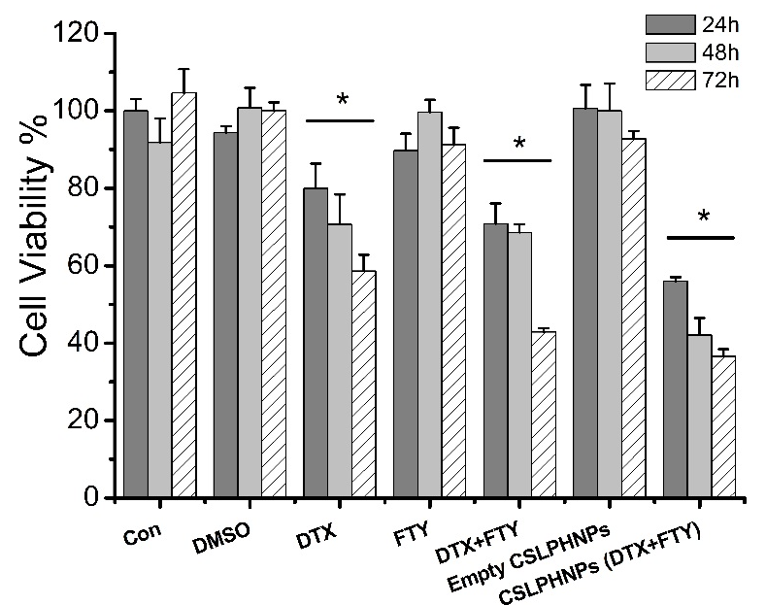
In vitro uptake and efficacy
Nanoparticles show excellent cancer cell intake and efficacy.
Wang et al, Scientific Reports 2017, 7: 5901

Slide 21
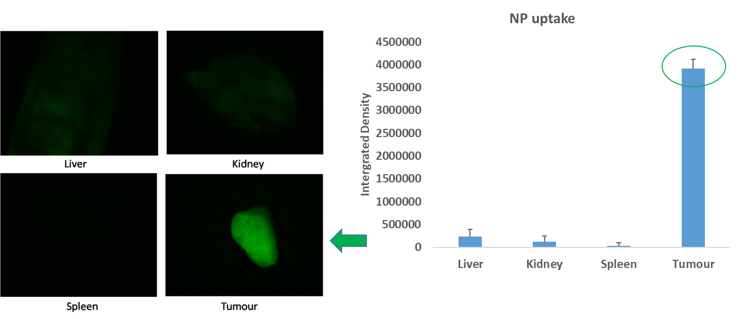
Tumour targeting evidence
Our nanoparticles show specific tumour targeting
PC-3 subcutaneous prostate cancer xenograft in nude mice. Fluorescent nanoparticles injected in tail vain and imaging performed in 24h.
Wang et al, Scientific Reports 2017, 7: 5901
Alshaker et al, Breast Cancer Res Treat 2017 Oct;165(3):531-543

Slide 22
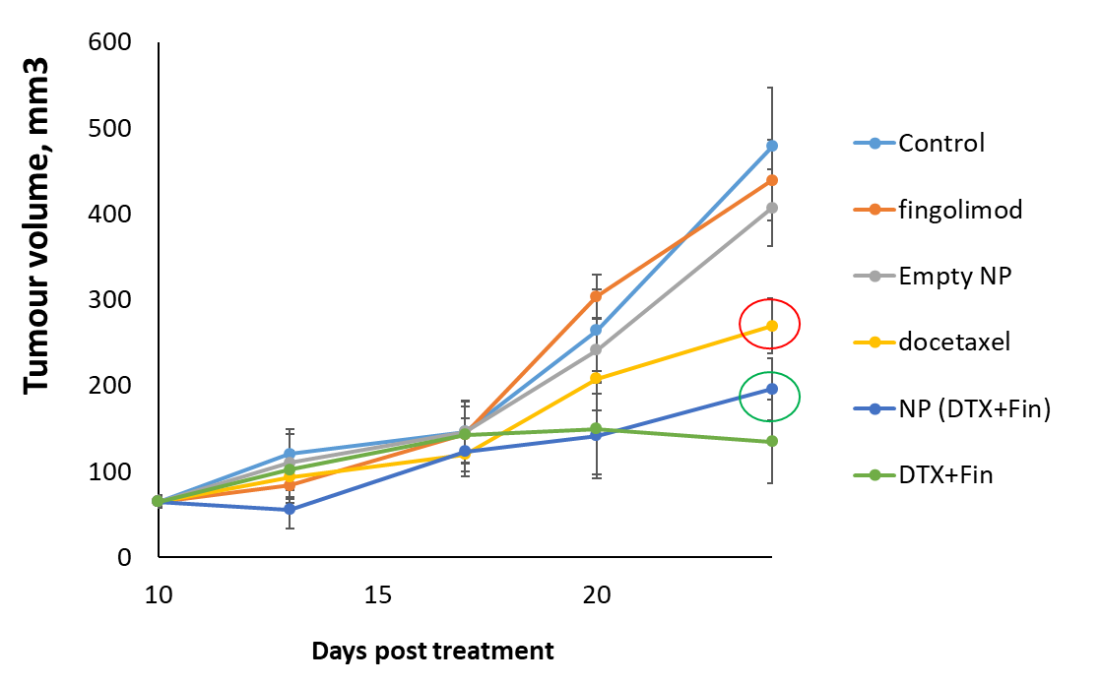
Efficacy evidence
Nanoparticles show superior efficacy to single systemic therapies.
4T1 mouse breast cancer xenograft in mammary pad of nude mice
tumour implantation
First treatment
Wang et al, Scientific Reports 2017, 7: 5901
Alshaker et al, Breast Cancer Res Treat 2017 Oct;165(3):531-543

Slide 23
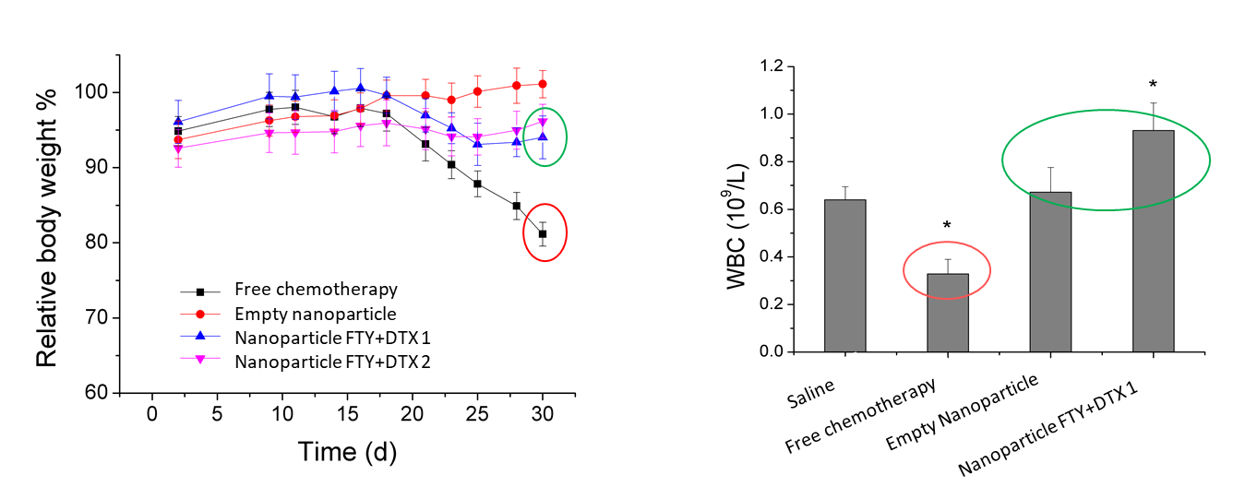
Toxicity studies
Nanoparticles show reduced toxicity compared to systemic therapies.
PC-3 subcutaneous prostate cancer xenograft in nude mice
No weight loss
No loss of white cells
Wang et al, Scientific Reports 2017, 7: 5901

Slide 24
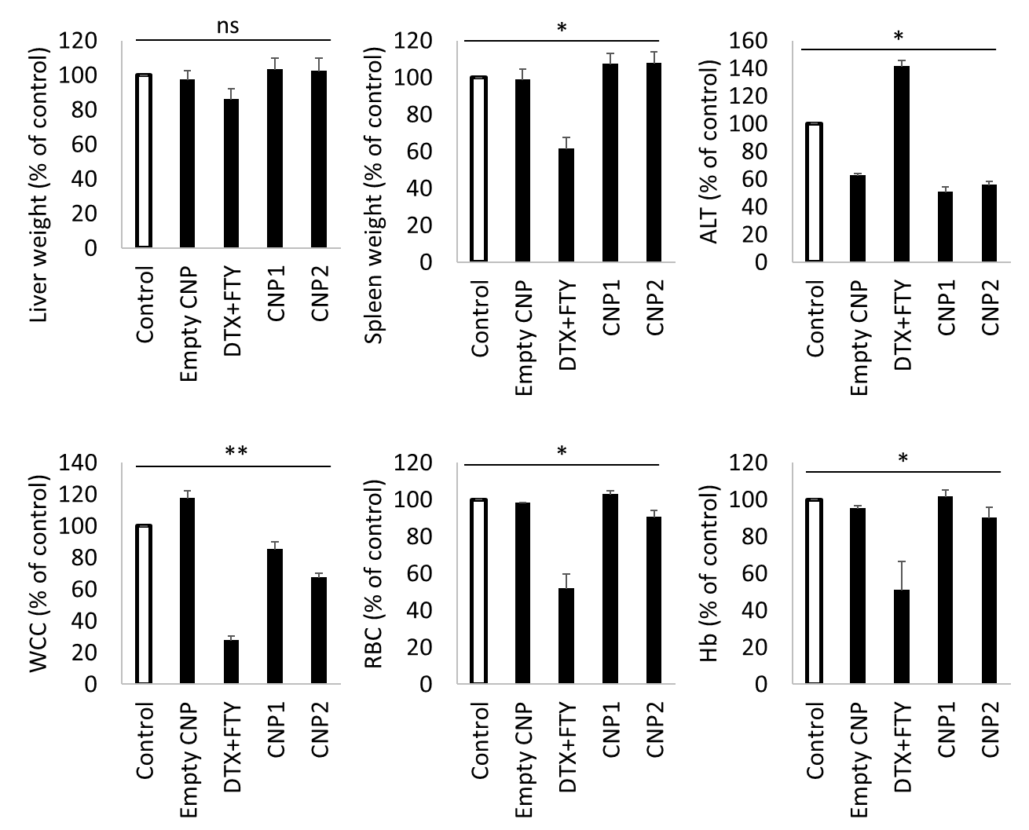
Toxicity studies
Nanoparticles show reduced toxicity compared to systemic therapies.
Breast cancer xenograft in nude mice
Alshaker et al, Breast Cancer Res Treat 2017 Oct;165(3):531-543

